Slide 1
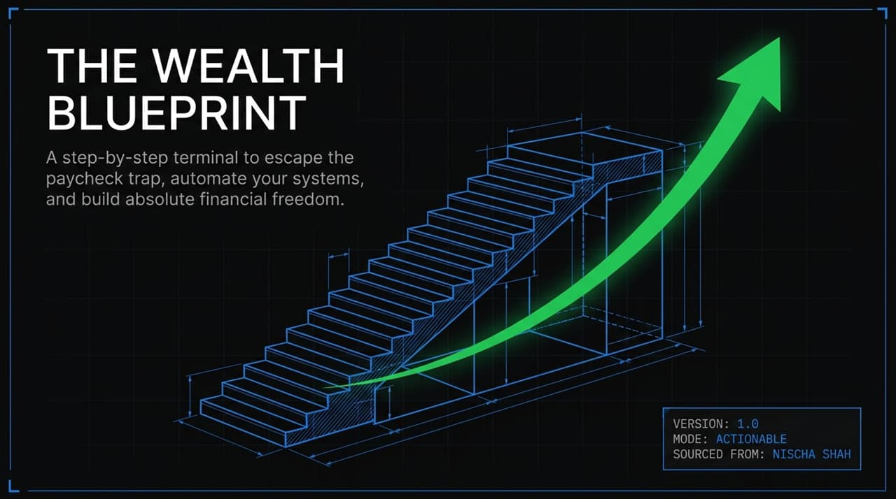
Notes:
https://www.youtube.com/watch?v=NxTsA72O5x0
Welcome, everyone. Today we are walking through The Wealth Blueprint—a practical, step-by-step framework designed to take you from paycheck-to-paycheck anxiety to complete financial independence. This blueprint isn't built on speculative stock picks or complex financial jargon; it’s based on mathematical realities, foundational behavioral psychology, and actionable systems sourced directly from former investment banker turned financial educator Nischa Shah. Whether you’re trying to clear high-interest debt or scale long-term compound growth, this presentation provides the exact operational sequence to reclaim control over your time and money.

Slide 2
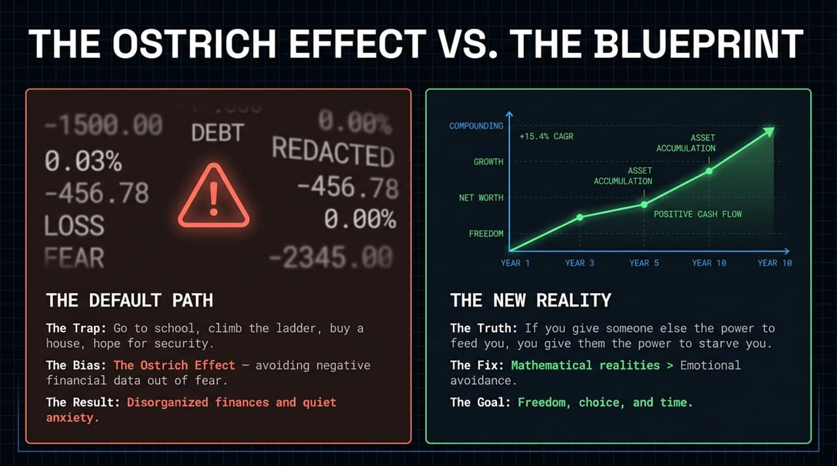
Notes:
Most people are living on what we call 'The Default Path'. You go to school, get a job, climb the corporate ladder, buy a house, and hope everything turns out okay in the end. But this default path often triggers a behavioral bias known as The Ostrich Effect. When money gets stressful, our brain's natural impulse is to stick our heads in the sand—we avoid checking bank accounts, ignore opening bills, and leave our financial lives disorganized out of sheer fear.
The New Reality requires a fundamental mind shift: If you give someone else the power to feed you, you give them the power to starve you. To gain true autonomy, we must replace emotional avoidance with simple mathematical rules. Our goal isn't just accumulating numbers on a screen; it's buying back freedom, choice, and time.

Slide 3
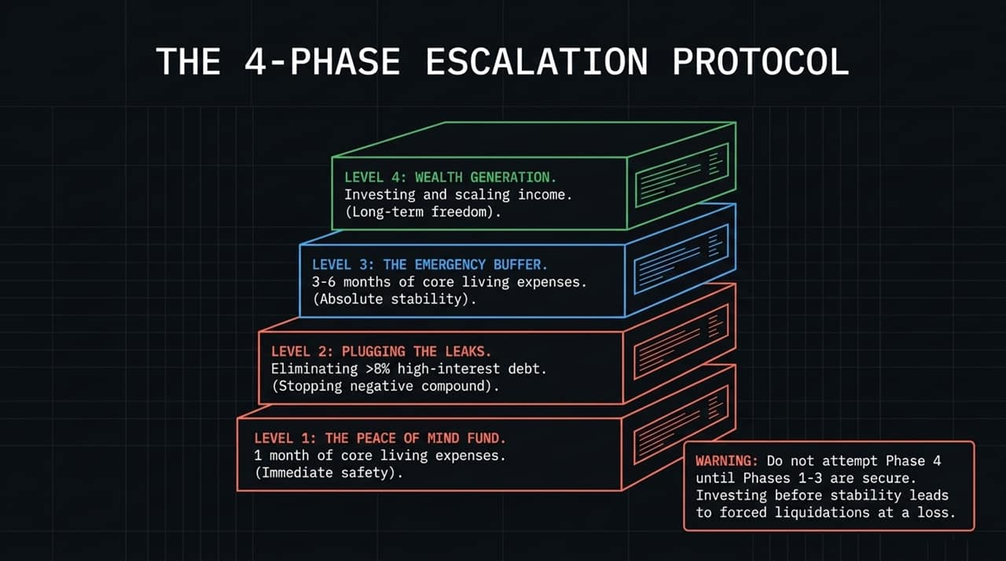
Notes:
To execute this blueprint without getting wiped out, we follow a strict 4-Phase Escalation Protocol:
Level 1 is your Peace of Mind Fund (1 month of core living expenses).
Level 2 is Plugging the Leaks (eliminating any high-interest debt over 8%).
Level 3 is The Emergency Buffer (3 to 6 months of expenses).
Level 4 is Wealth Generation (investing and scaling income).
Crucial Warning: You must never jump straight to Phase 4 investing before securing Levels 1 through 3. If you invest all your extra cash into the stock market without a buffer, the moment life throws a curveball, you'll be forced to liquidate your investments at a loss just to cover basic survival expenses.

Slide 4
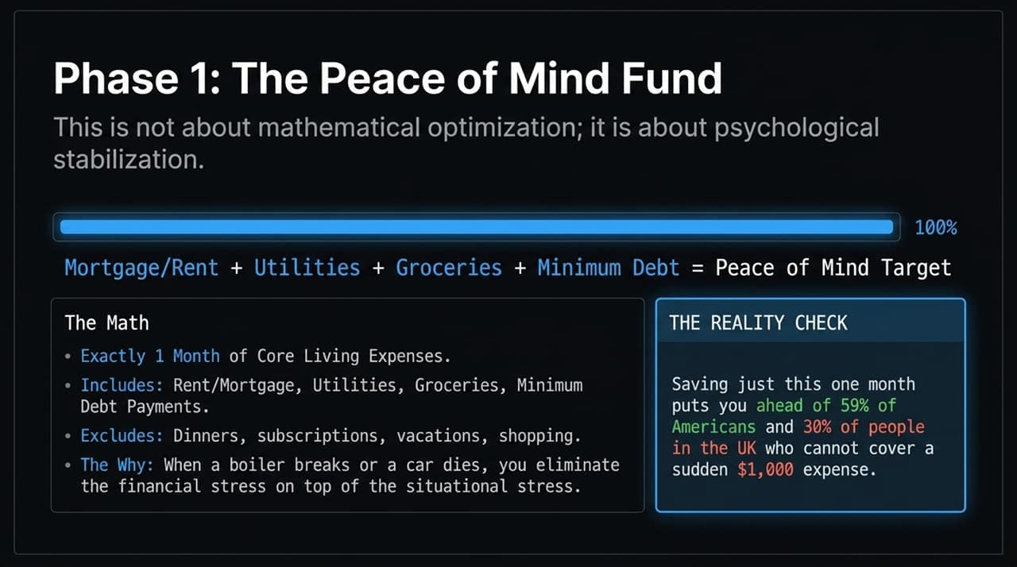
Notes:
Phase 1 is not an exercise in mathematical optimization; it’s about psychological stabilization. Your target here is exactly 1 month of core living expenses.
What goes into core expenses? Rent or mortgage, basic utilities, basic groceries, and minimum debt payments. Do not include dining out, subscriptions, or shopping.
Why build this first? Because when your boiler breaks down or your car blows a tire, having cash on hand eliminates the financial emergency on top of the situational crisis. Reality Check: Saving just this single month of expenses instantly puts you ahead of 59% of Americans and 30% of UK residents who cannot cover an unexpected $1,000 cash expense without taking on debt.

Slide 5
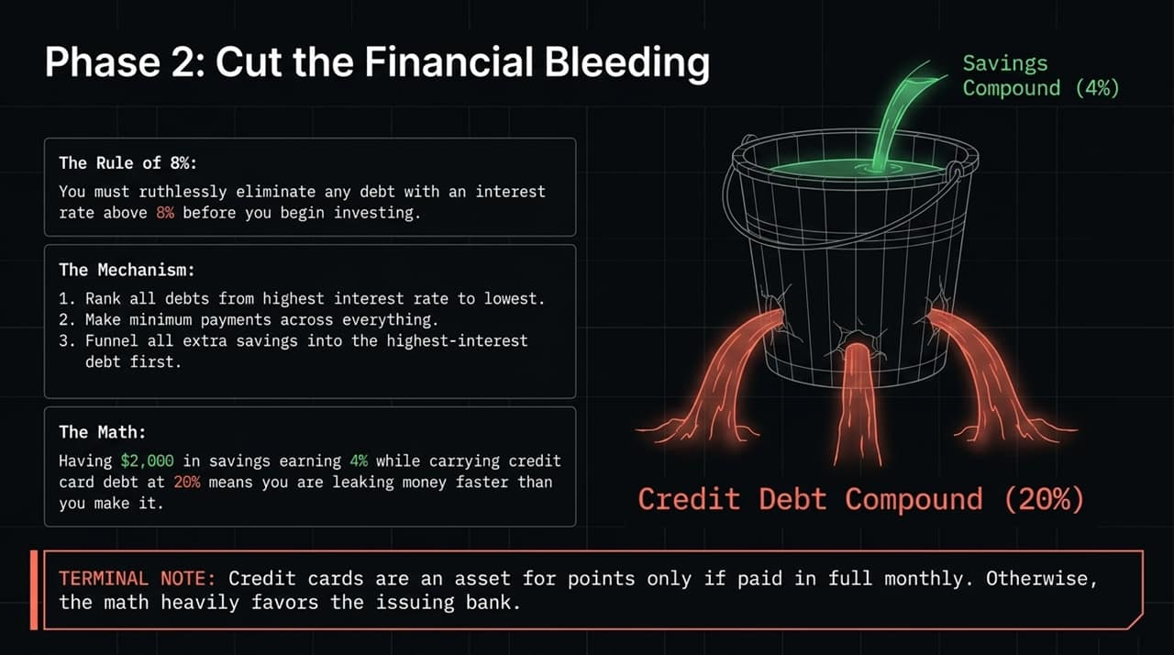
Notes:
Phase 2 focuses on plugging your financial leaks by implementing The Rule of 8%. Any debt with an interest rate above 8%—such as credit card balances or personal loans—must be eliminated before you begin investing.
Consider the math visual on screen: Holding $2,000 in a savings account earning 4% interest while carrying a credit card balance charging 20% interest means you are losing 16% on your money every single year. You're leaking money far faster than your savings can grow.
Execution: Rank all your debts from highest interest rate to lowest. Pay the minimums on everything, and throw every extra dollar at the highest-interest debt first. Credit card rewards points are only beneficial if you clear your balance in full every month; otherwise, the mathematical math heavily favors the issuing bank.

Slide 6
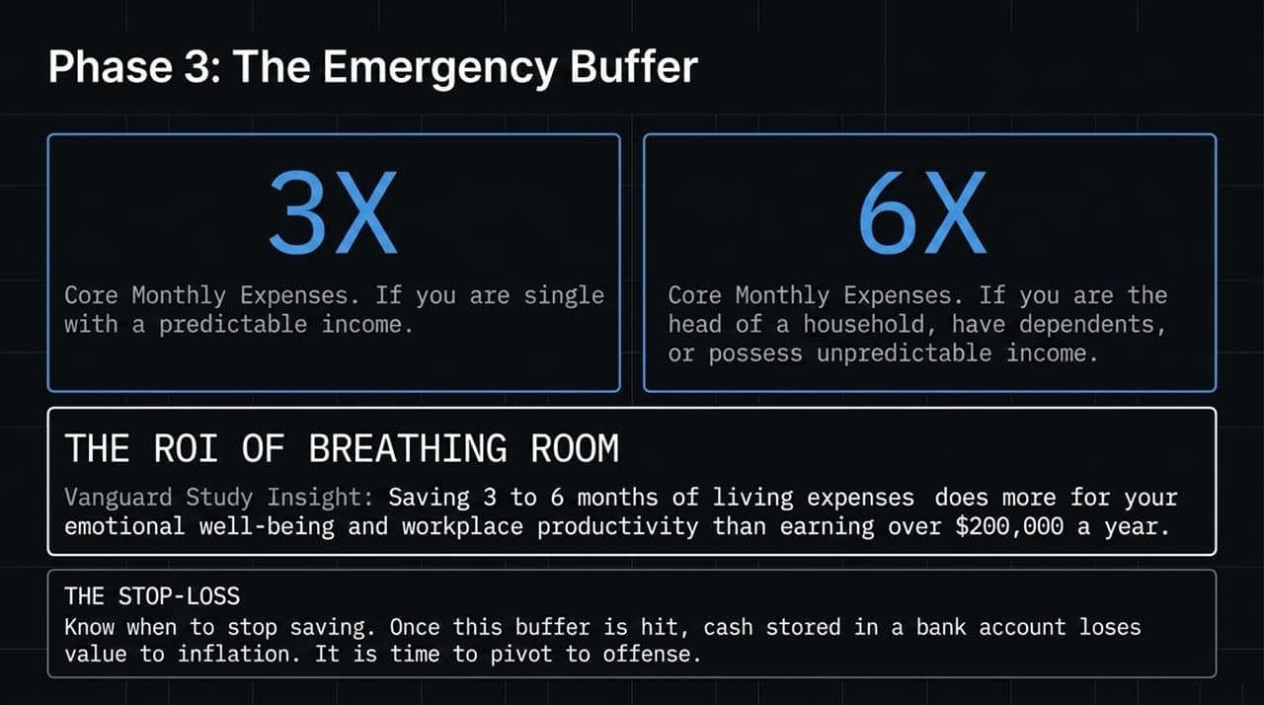
Notes:
Once high-interest debt is wiped out, you build Phase 3: The Emergency Buffer.
If you are single with stable, predictable income, target 3 months of core living costs.
If you have dependents, a family to support, or variable income, build a 6-month buffer.
A landmark Vanguard study revealed that holding 3 to 6 months of living expenses provides a bigger boost to your psychological well-being and workplace productivity than earning over $200,000 a year with no cash reserve.
The Stop-Loss Rule: Once this target is hit, stop saving cash. Excess cash in a traditional bank account gets eaten alive by inflation. Once the buffer is full, you pivot from defense to offense.

Slide 7
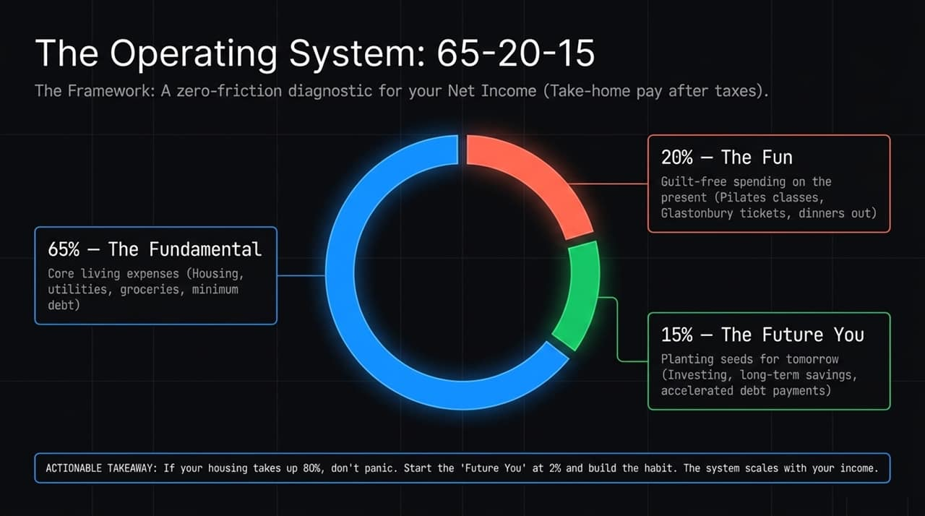
Notes:
To manage your day-to-day cash flow without friction, use the 65-20-15 Framework based on your net take-home pay:
65% for Fundamentals: Essential living costs (housing, groceries, utilities, debt minimums).
20% for Fun: Guilt-free present-day enjoyment—dinners out, vacations, concert tickets. Spending on what brings you joy today keeps you consistent long-term.
15% for Future You: Capital allocated strictly to investing, building long-term assets, or accelerated debt paydown.
Actionable Takeaway: If high rent means your fundamental costs currently eat up 80% of your income, don't throw away the system. Start 'Future You' at just 2% or 5% to build the behavioral habit first. As your income grows, scale up to the targets.

Slide 8
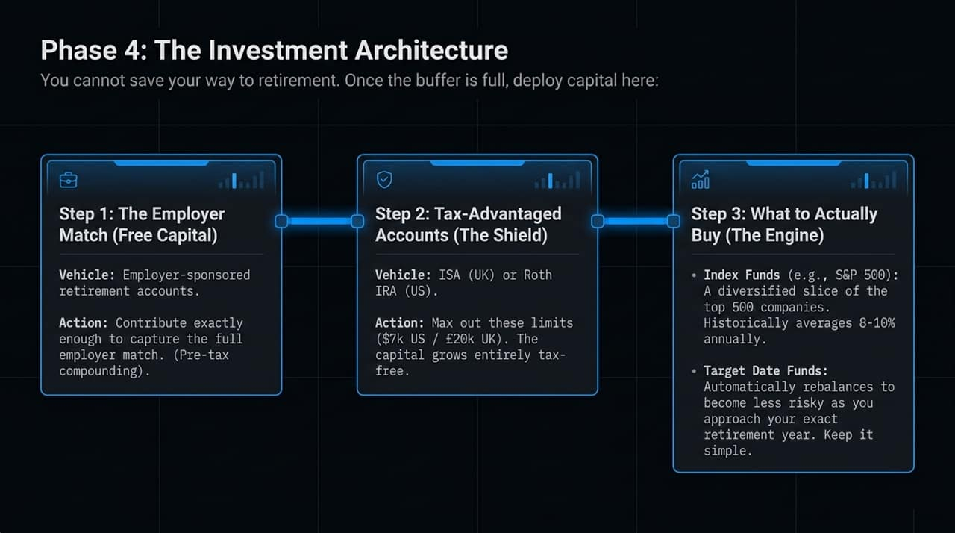
Notes:
Phase 4 is where long-term wealth is unlocked. You cannot save your way to retirement; you must deploy capital systematically through three main vehicles:
Step 1: Employer Match: Always contribute enough to get 100% of your employer's retirement contribution match. This is immediate, tax-advantaged 100% return on your money—never turn down free capital.
Step 2: Tax-Advantaged Accounts: Maximize tax shields like the Roth IRA in the US ($7k limit) or ISA in the UK (£20k limit). Inside these wrappers, your investments compound and can be withdrawn completely tax-free.
Step 3: Asset Selection: Keep it simple. Broad-market Index Funds (like an S&P 500 fund) give you ownership in top companies with historical long-term returns of 8–10%. Alternatively, Target Date Funds adjust risk automatically as you age.

Slide 9
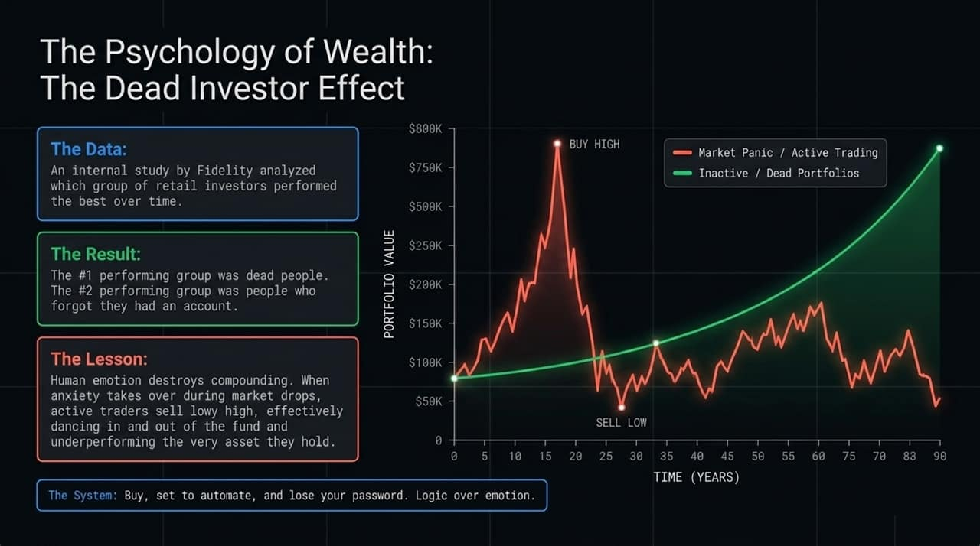
Notes:
Managing investments is 10% math and 90% human psychology. Look at this chart based on a famous internal study conducted by Fidelity. They analyzed which retail investor accounts performed best over time.
The #1 best-performing group was literally dead people. The #2 best-performing group was people who had completely forgotten they owned an account!
Why? Active trading driven by market panic causes humans to buy high during euphoria and sell low during market crashes. Every time you panic-sell, you destroy compounding returns. The lesson is simple: Set up automated contributions, buy broad index funds, lock the account, and 'lose your password'.

Slide 10
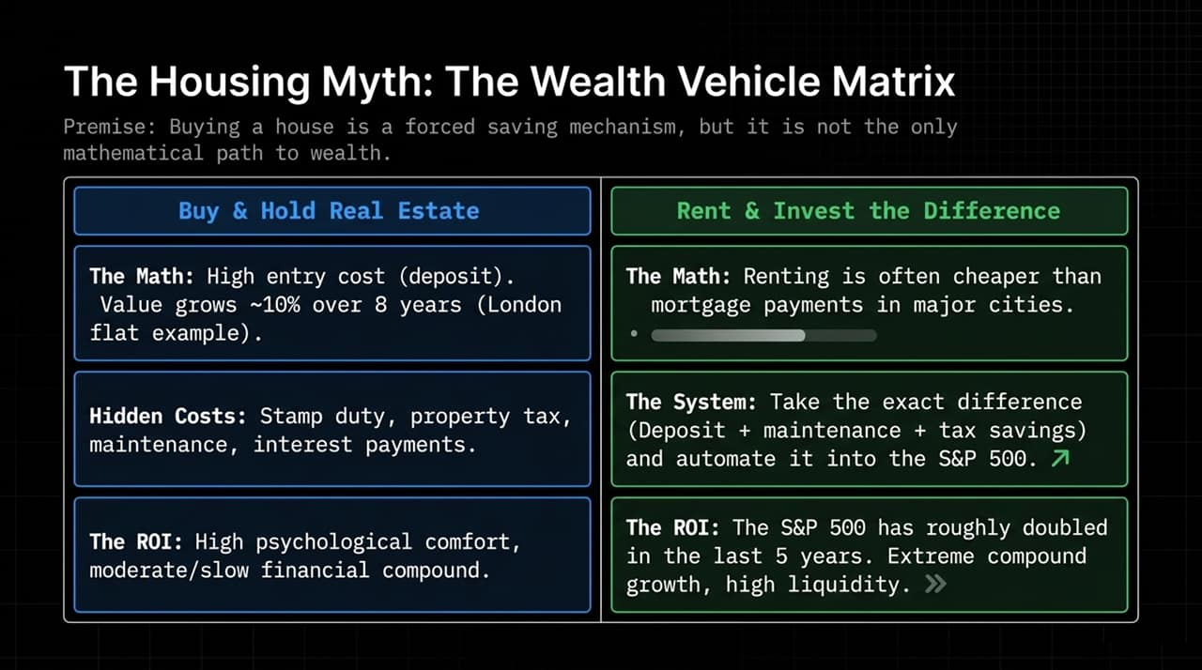
Notes:
Society conditions us to believe that buying a home is the only valid path to wealth. In reality, homeownership is just a forced savings mechanism—not an absolute mathematical mandate.
Option A (Buy & Hold): Property requires significant down payments and carries heavy overhead costs—stamp duty, taxes, interest, maintenance, and insurance. While property builds equity, growth can be slow depending on the market.
Option B (Rent & Invest the Difference): In many major cities, renting is cheaper month-to-month than mortgage payments on an equivalent property. If you rent and systematically invest the saved deposit, maintenance, and tax cash directly into low-cost index funds, you achieve liquidity and powerful compounding growth.
Choose property for lifestyle stability, not because society told you it's the only way to build net worth.

Slide 11
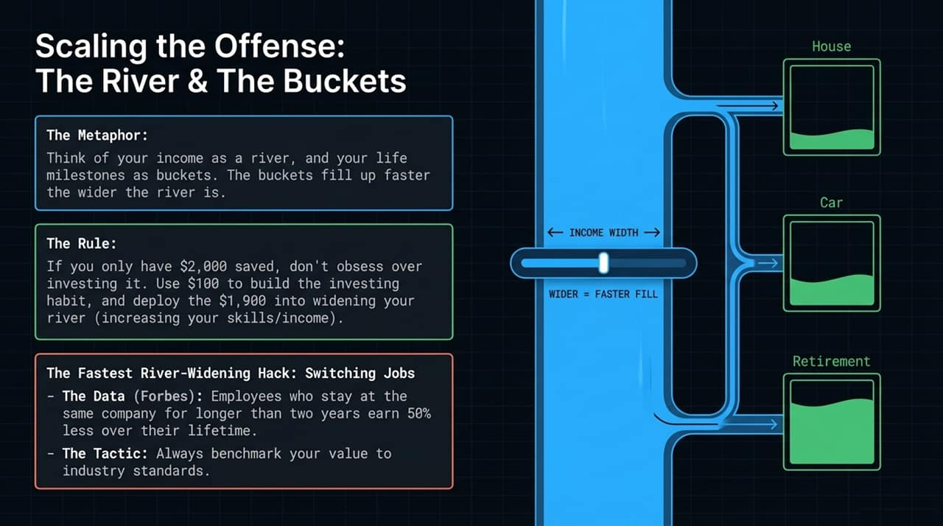
Notes:
Defensive budgeting can only take you so far. To supercharge compounding, you must scale your offense. Think of your total income as a flowing river, and your financial goals (house, car, retirement) as buckets. The wider your income river, the faster every bucket fills.
The $2,000 Rule: If you only have $2,000 in extra cash, don't spend months stressing over complex stock trades. Put $100 into an index fund to keep the habit active, and invest the remaining $1,900 into high-value skill development to widen your income river.
The Career Hack: Data shows employees who stay at the same company longer than two years earn up to 50% less over their lifetime compared to those who strategically job-hop. Regularly benchmark your market value.

Slide 12
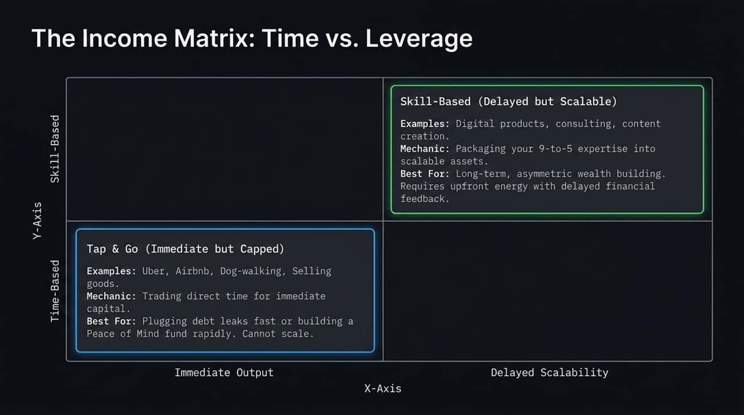
Notes:
When evaluating side income or alternative revenue sources, understand where your time sits on The Income Matrix:
Time-Based (Tap & Go): Driving for Uber, dog walking, or selling unused items provides immediate cash output, but your earnings are capped by the hours in a day. Use this strictly for plugging high-interest debt or filling Phase 1 rapidly.
Skill-Based (Delayed but Scalable): Packaging your 9-to-5 domain expertise into digital products, consulting, or media creation. Upfront efforts yield zero immediate payout, but over time, these assets decouple your earning power from physical hours worked. This creates true, scalable wealth.

Slide 13
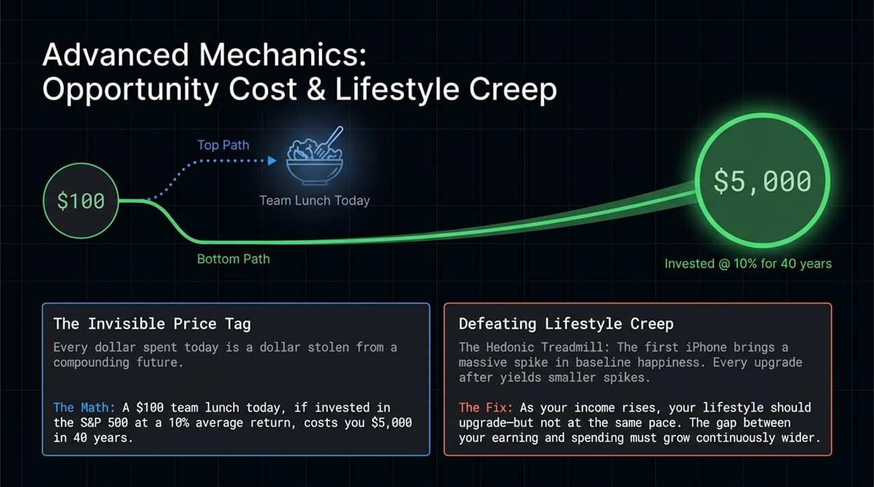
Notes:
To protect your growing income, you must navigate two advanced traps:
The Invisible Price Tag (Opportunity Cost): Every dollar spent today steals compounding capacity from your future. A $100 team lunch today, if invested in an index fund averaging 10% annual returns over 40 years, carries a true long-term price tag of $5,000.
Defeating Lifestyle Creep: The Hedonic Treadmill dictates that upgrading your lifestyle yields temporary spikes in happiness that quickly revert to baseline. As your salary increases, allow your lifestyle to upgrade modestly, but ensure the gap between what you earn and what you spend widens consistently.

Slide 14
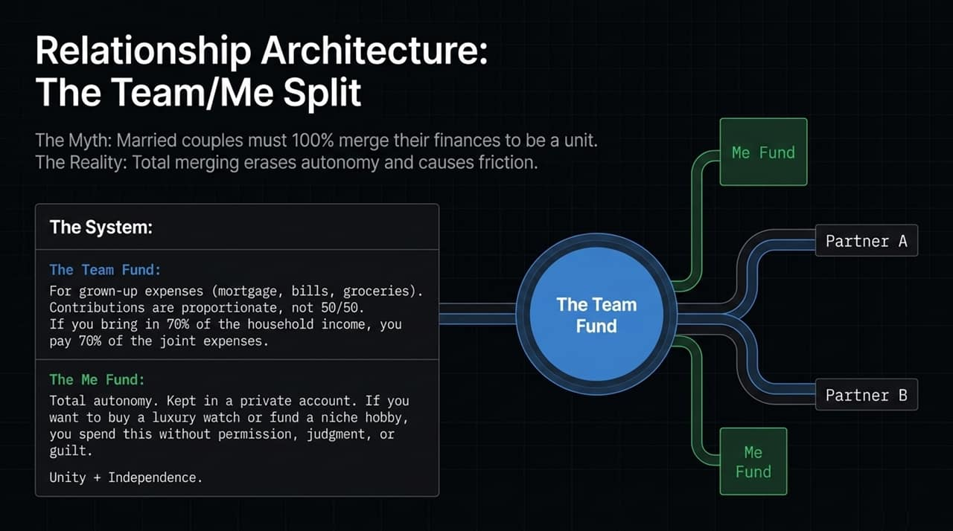
Notes:
Money is one of the leading causes of relationship friction. The common assumption that partners must combine 100% of their finances often leads to resentment. The ideal structure is the Team / Me Split:
The Team Fund: A joint account for shared core expenses (housing, utilities, groceries). Contributions should be proportional, not 50/50. If Partner A earns 70% of total household income, they contribute 70% of team expenses.
The 'Me' Funds: Separate, private accounts for each individual. This provides complete autonomy. Want to buy a luxury watch or finance a niche hobby? You spend from your 'Me' fund without requiring permission, guilt, or judgment.

Slide 15
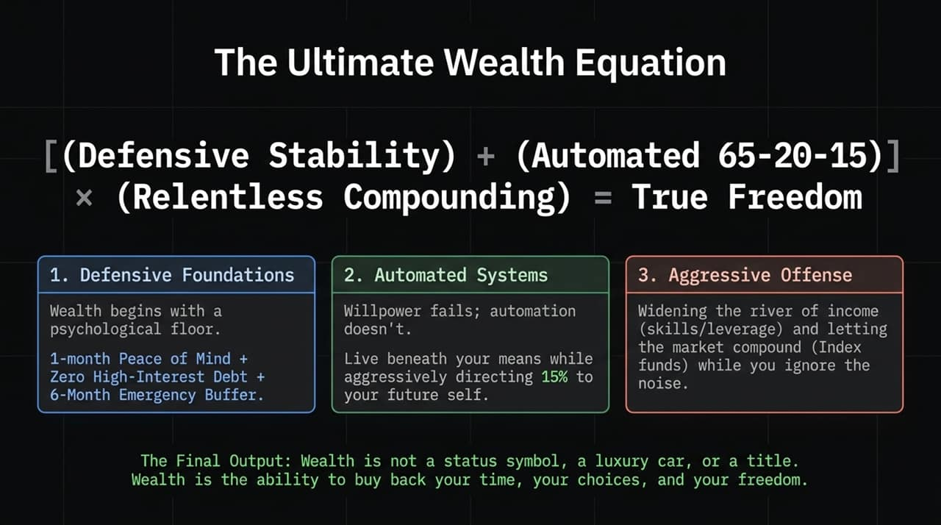
Notes:
We bring the entire framework together in The Ultimate Wealth Equation:
[(Defensive Stability) + (Automated 65-20-15)] x (Relentless Compounding) = True Freedom
Build a solid defensive foundation (1-month Peace of Mind + 0% high-interest debt + 6-month buffer).
Automate your cash flow using the 65-20-15 framework.
Scale your income offense and allow broad market compounding to run uninterrupted.
Always remember: Real wealth is not about flaunting luxury cars, status symbols, or titles. True wealth is the freedom to buy back your time, your choices, and your life.

Slide 16
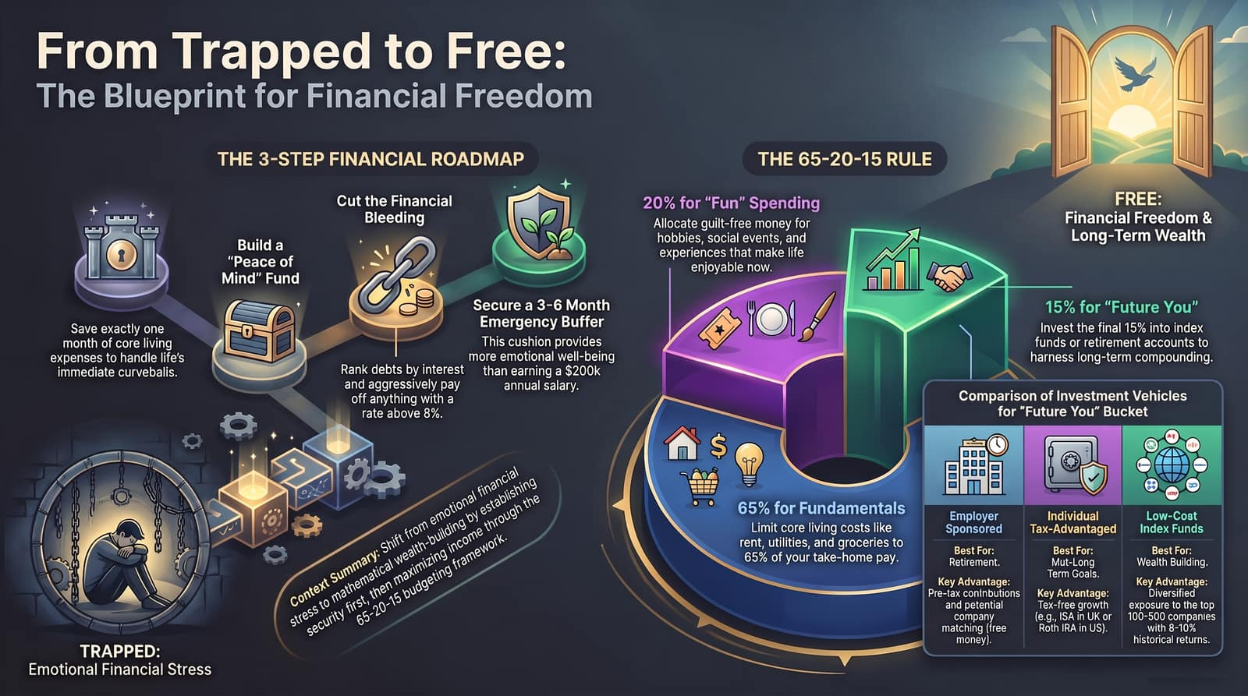
Notes:
To wrap up, here is your summary action plan:
The 3-Step Roadmap: Secure your 1-month Peace of Mind fund. Eliminate all high-interest debt (>8%). Build your 3-to-6 month emergency cushion.
The 65-20-15 Execution: Direct 65% to living essentials, 20% to current enjoyments, and 15% straight into long-term compounding assets.
Deployment Vehicles: Take full advantage of workplace matching, max out tax-shielded accounts like Roth IRAs or ISAs, and rely on diversified, low-cost index funds.
Shift your financial life from emotional stress to clear, mathematical systems. Thank you!

